Slide 1


micro:bit programming tutorial
Lesson 16
micro:bit basic lesson 16“Knob controller”
Yahboom micro:bit tutorial

Slide 2
micro:bit programming tutorial
Part1
Part 2
Part3
Part 4
Learning goals
Preparation
Search for blocks
Combine blocks
Yahboom micro:bit tutorial

Slide 3
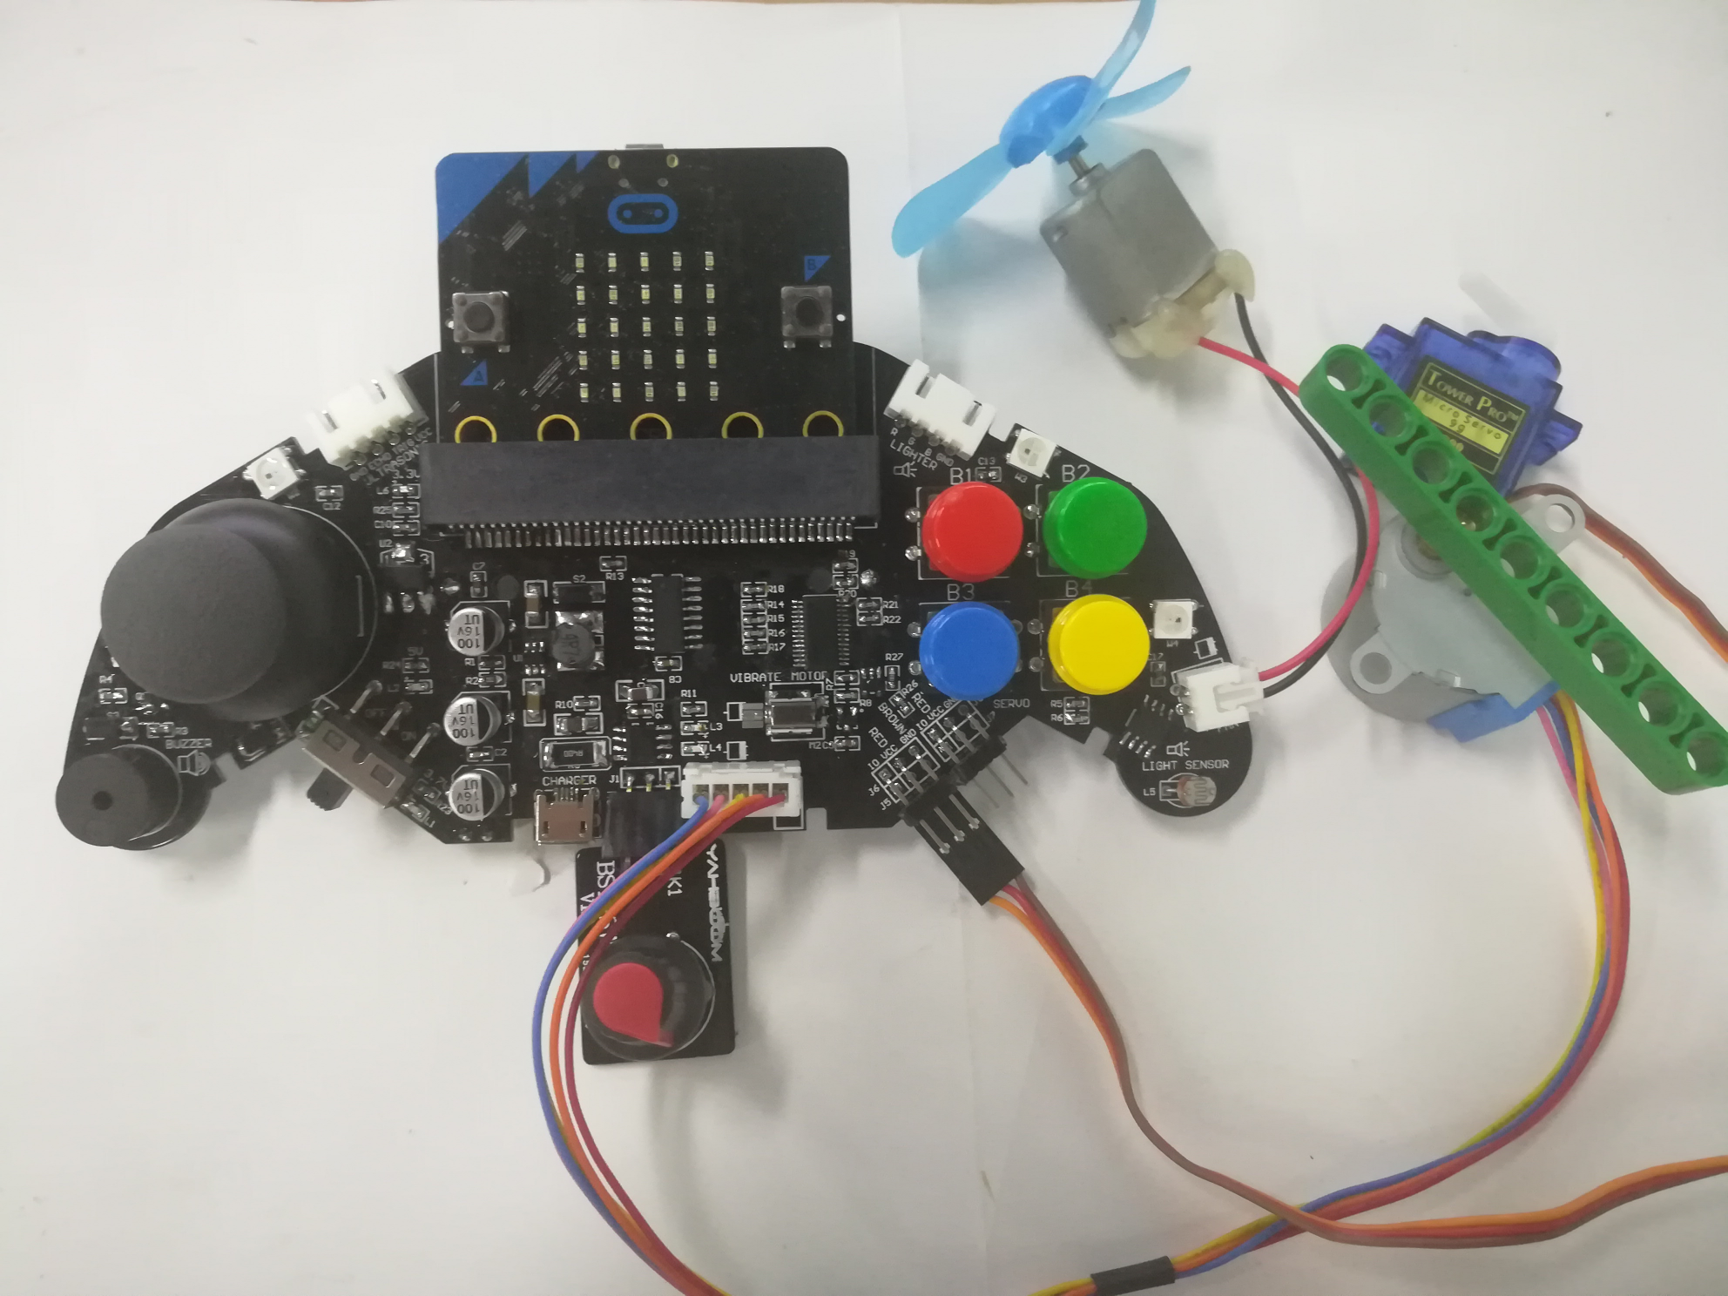
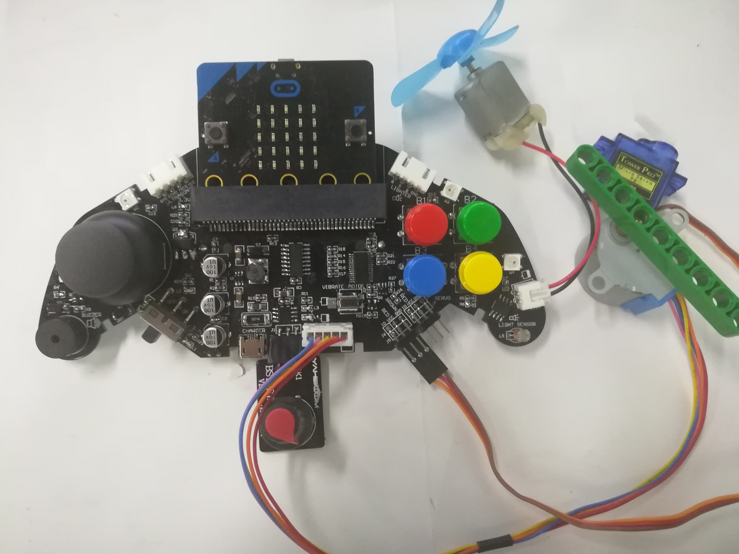
micro:bit programming tutorial
Part1
学习目标
Rotate the knob potentiometer to different gear positions, the fan speed and the angle of the servo and the speed of the stepper motor will change accordingly.
Yahboom micro:bit tutorial

Slide 4
micro:bit programming tutorial
Part2
Hardware：
● 1 X micro:bit Game Handle
● 1 X Micro USB Cable
● 1 X Knob potentiometer
● 1 X fan
● 1 Xservo
● 1 Xstepper motor
Yahboom micro:bit tutorial

Slide 5
micro:bit programming tutorial
Two programming methods
Part2
1.Online: Connect Micro:bit to the computer via USB cable, and the computer will pop up a U disk and click the URL in the U disk to enter the programming interface.Enter this URL https://github.com/lzty634158/GHBit to get the package named GHBit.
2.offline：Open micro:bit offline programming software and add GHBit package.Click on "Advanced" and select "Add Package".Enter this URL https://github.com/lzty634158/GHBit to get the package named GHBit.
Note: If you already have a GHBit package, you don't need to add it repeatedly.
Yahboom micro:bit tutorial

Slide 6
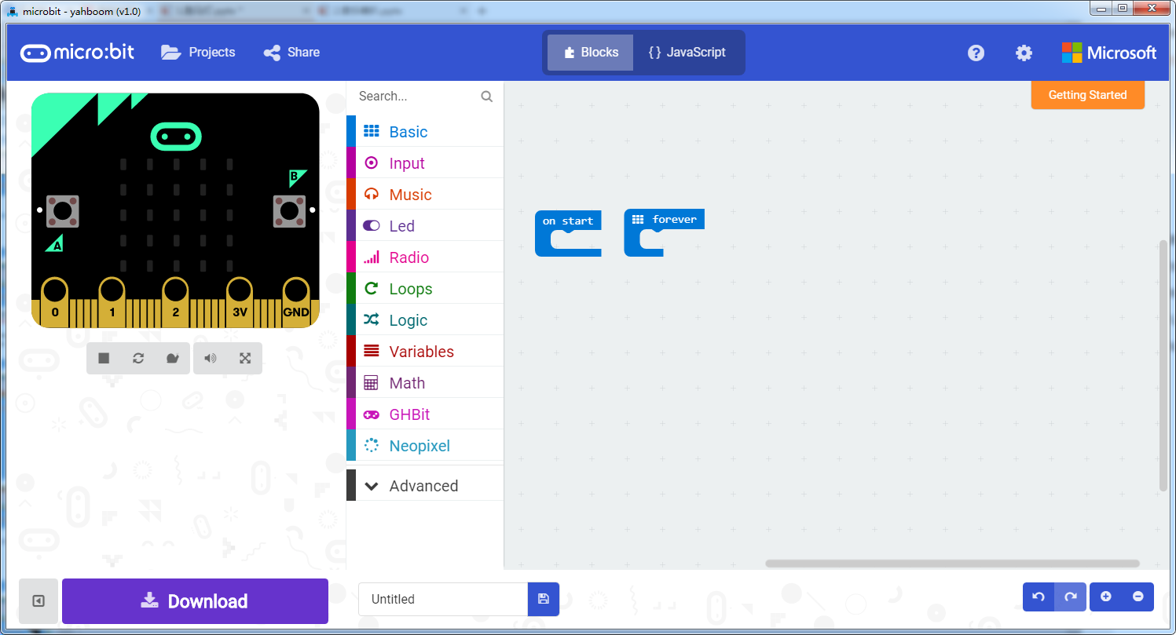
micro:bit programming tutorial
Programming interface
Part3
Yahboom micro:bit tutorial

Slide 7
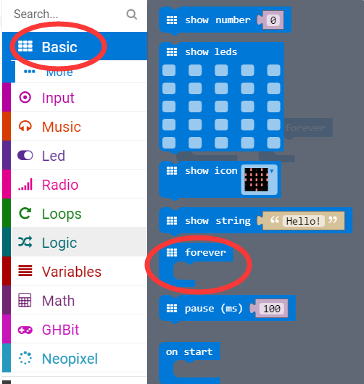
micro:bit programming tutorial
Part3
Start programming
The “forever” building block means that when the micro:bi Game Handle is turned on, the blocks in “forever” are repeatedly executed.
Yahboom micro:bit tutorial

Slide 8
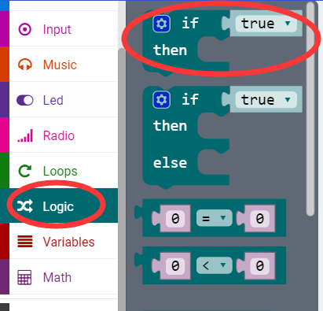
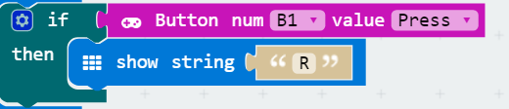
micro:bit programming tutorial
Part3
If a value is true, then do some statements.
For example: If the B1 button of the handle is pressed, the dot matrix display character R is executed. If the B1 button is not pressed, it will not be executed.
Yahboom micro:bit tutorial

Slide 9
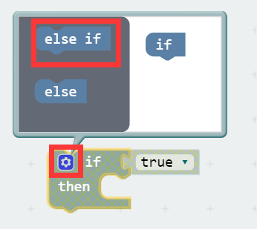
micro:bit programming tutorial
Part3
When there are many choices, you can click on the pinion above. Drag the "else if" on the left to the bottom of the "if" on the right, and click on the pinion again.
Yahboom micro:bit tutorial

Slide 10
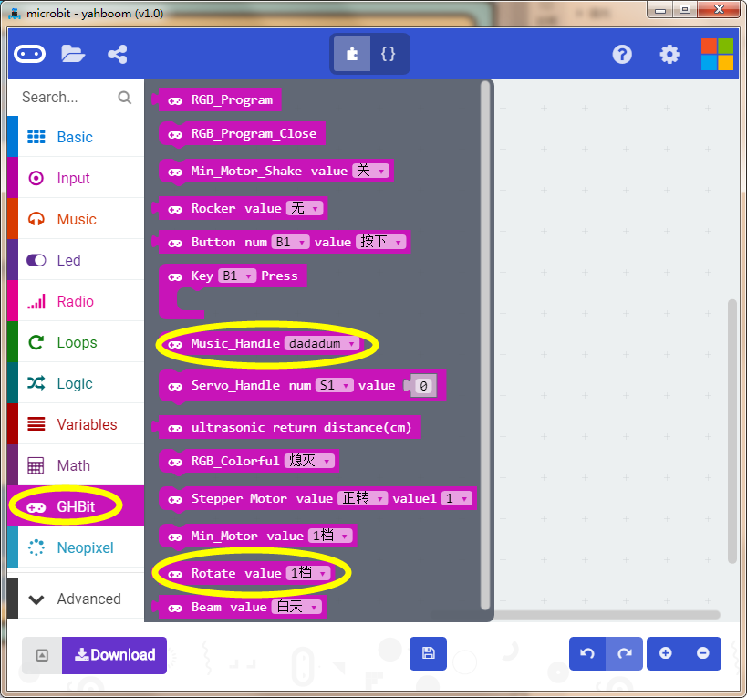
micro:bit programming tutorial
Part3
探索积木
This is the knob potentiometer building block, in which the gear position can be modified by yourself!
Yahboom micro:bit tutorial

Slide 11
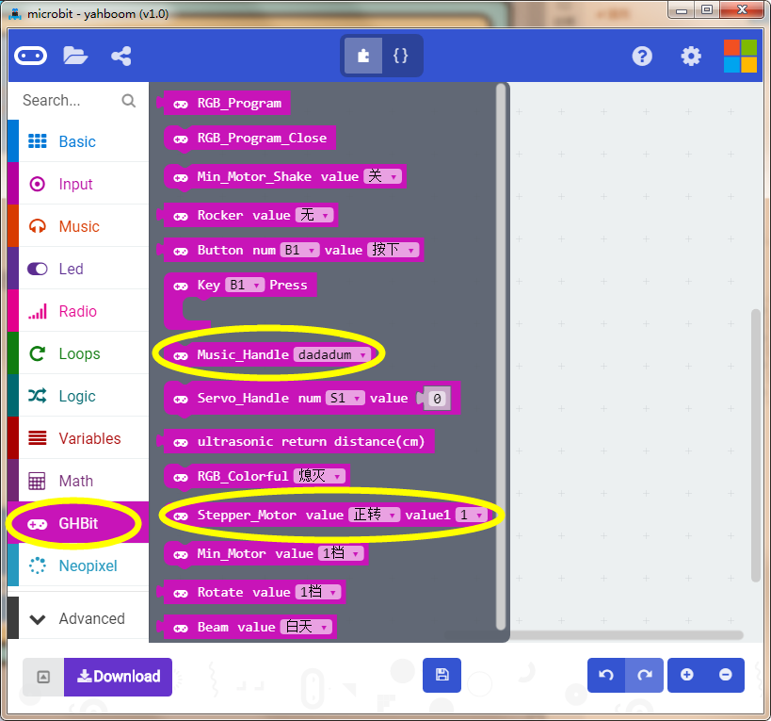
micro:bit programming tutorial
Part3
探索积木
This is the stepper motor speed control block, you can change the gear position to change the direction of rotation!
Yahboom micro:bit tutorial

Slide 12
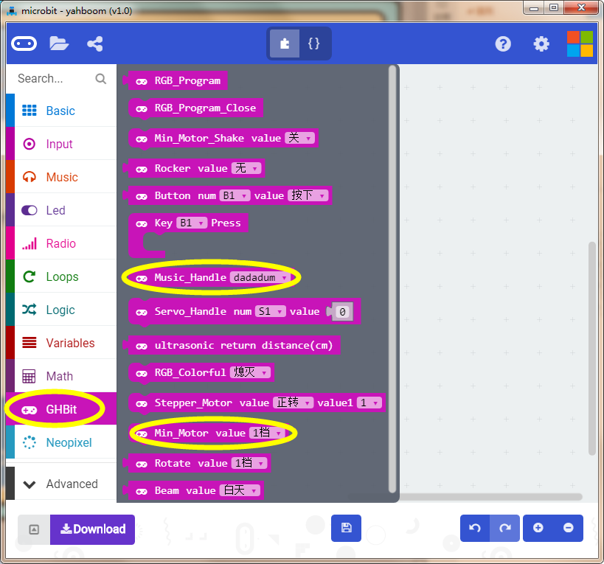
micro:bit programming tutorial
Part3
探索积木
This is a fan speed control block that can be changed to adjust the wind speed！
Yahboom micro:bit tutorial

Slide 13
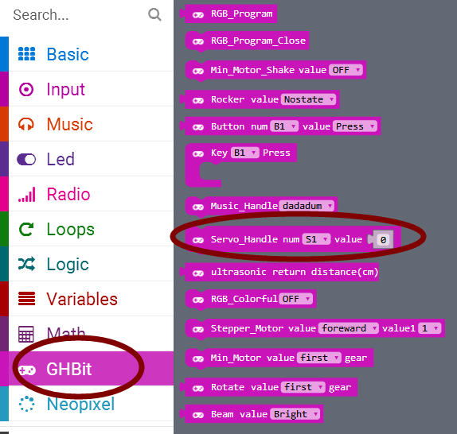
micro:bit programming tutorial
Part3
探索积木
This is the servo adjustment block that can change the servo angle.
Yahboom micro:bit tutorial

Slide 14
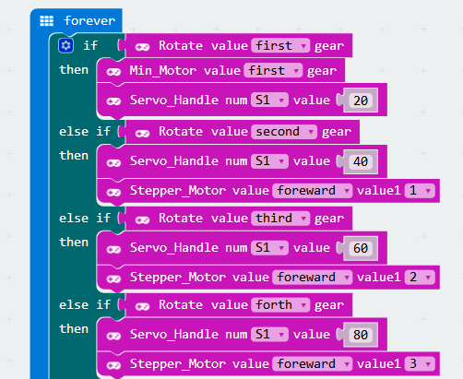
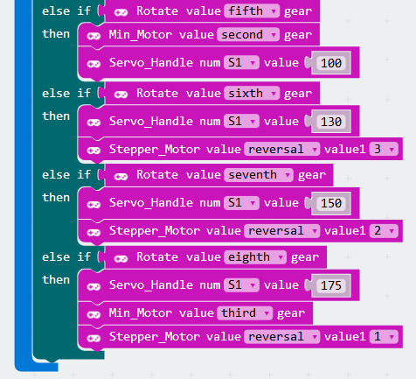
micro:bit programming tutorial
Part4
This is the complete building block for this course, let's download it to the micro:bit Game Handle.
Combination building block
Yahboom micro:bit tutorial

Slide 15
micro:bit programming tutorial
micro:bit
Thanks for watching！
Yahboom
Yahboom micro:bit tutorial

